Slide 1


Bank of Baroda Hackathon - 2022
Technology Partner
Your Team Name : Dream Tech
Your team bio : Coming together is a beginning. Keeping together is progress. Working together is success.
Date :14/09/202

Slide 2
Problem Statement?
Banking sector stash the cash in many branches Which has been located in both urban and rural areas. To maintain security in ever branch is very difficult task for the bank sectors.
Sometimes it is complicate to manage large number of cameras which is often result in failure. Because there is some trouble like a system failure or some incident occurs in such condition the camera was not working.
To overcome this problem video analytics for banking is key to facing these demands.

Slide 3
User Segment & Pain Points
Deliver the best possible user experience
Streaming video analytics means real-time visibility
All the insights you need, in one platform
Deliver better customer care
Understand your audience
Segment your viewers
Improve security

Slide 4
Pre-Requisite
Some applications in the field of video analytics are widely known to the general public. One such example is video surveillance, a task that has existed for approximately 50 years. In principle, the idea is simple: install cameras strategically to allow human operators to control what happens in a room, area, or public space.
In practice, however, it is a task that is far from simple. An operator is usually responsible for more than one camera and, as several studies have shown, upping the number of cameras to be monitored adversely affects the operator’s performance. In other words, even if a large amount of hardware is available and generating signals, a bottleneck is formed when it is time to process those signals due to human limitations.
Video analysis software can contribute in a major way by providing a means of accurately dealing with volumes of information.

Slide 5
Azure tools or resources
->TubeBudd ->Vidyard ->Vidooly ->Tubular ->Vidiq ->Viralstat

Slide 6
Any Supporting Functional Documents
Video Analytics and Lens Calculator: Easily calculate how far a camera can see and at what distance it can detect objects with built-in video analytics.
Essential Video Analytics datasheet: Datasheet Essential Video Analytics 6.60.
Intelligent Video Analytics datasheet: Datasheet Intelligent Video Analytics 7.10.
Video Analytics release letter: Release note 6.60

Slide 7
Key Differentiators & Adoption Plan
Key different of our project is mostly video analytics in surveillance camera are not used in bank sector. Video security systems are used across cities, facilities, and organizations to detect and deter crime and other security risks. We use in bank sector to monitor the customer sentiments, understand the patterns, behaviours, actions in certain branches for proactive surveillance and provide better services to customers. Traditional video security systems provide the infrastructure only to capture, store and distribute video, leaving the task of threat detection to human operators. This task is time consuming, tedious and error prone due to human fatigue.
Adoption Plan for this project. Establish a Vision, Prioritize Features, Assign Resources and Deploy the Adoption Plan, Measure Success Rate.

Slide 8
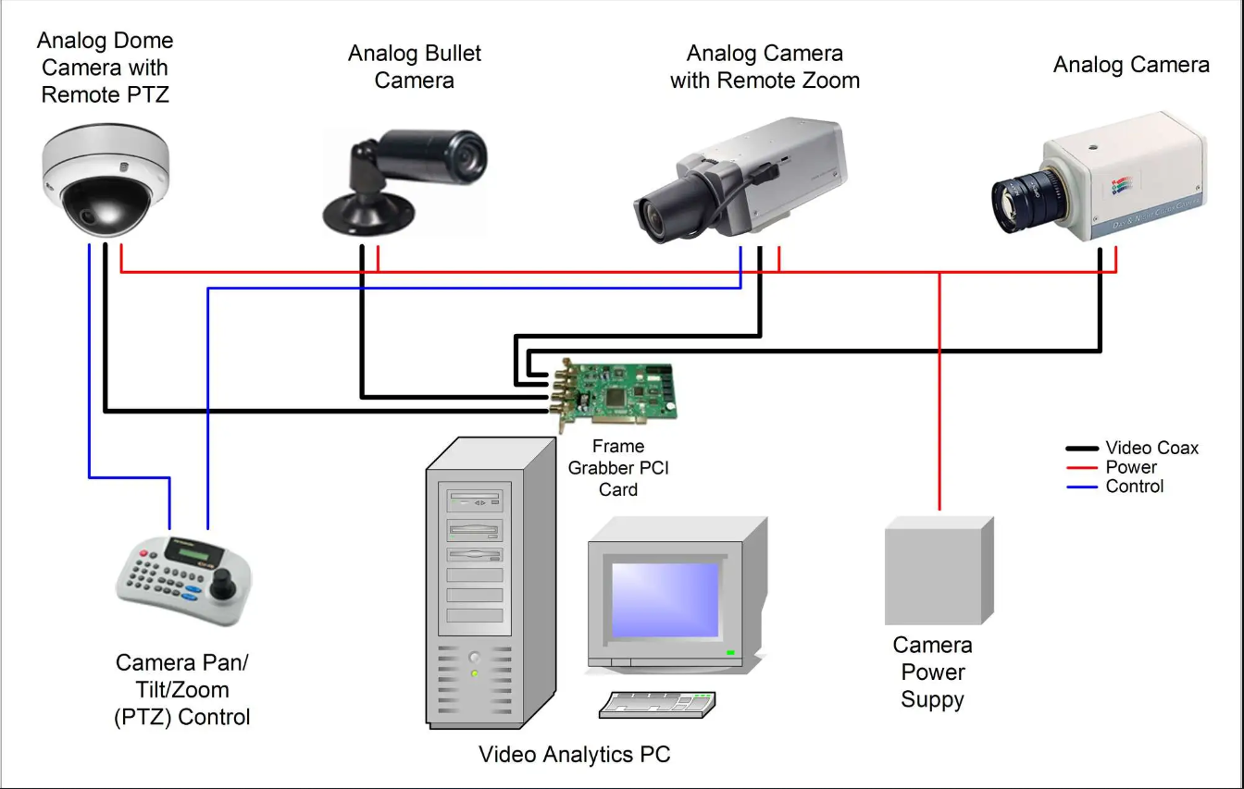
GitHub Repository Link & supporting diagrams, screenshots, if any

Slide 9
Thank You
Moureesh P
Shrithar R
Nikitha P
Ranjani T

